Slide 1
Introducing the Open Cloud Initiative (OCI)
By John Mark Walker
VP & Co-founder, OCI
Storage and Cloud Community Guy, Red Hat
@johnmark

Slide 2
WHY OCI?

Slide 3
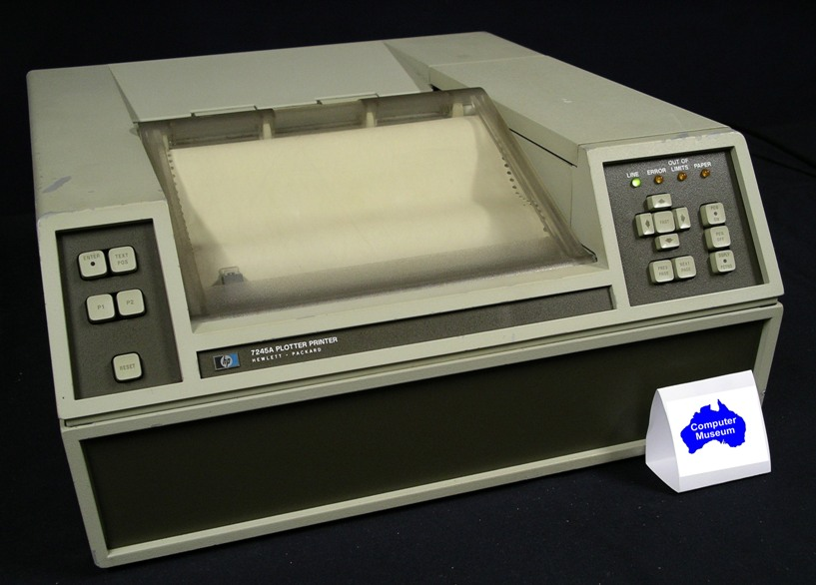
Why OCI?
MOAR LOCK-IN PLZ
      The lock-in that launched a thousand lines of code

Slide 4
Why OCI?
“Whatsa matta with a little locking”
“Lock-in, moron, lock-in”

Slide 5
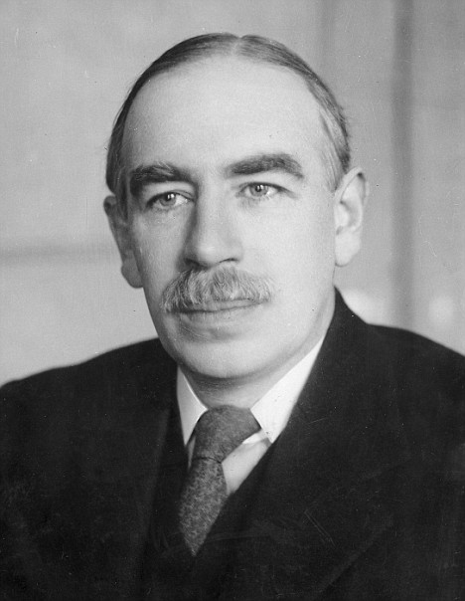
Lock-in
Although lock-in is a dirty word, Some is necessary

Slide 6
Lock-in
Keynesian view: the world is full of monopolies
  No such thing as frictionless economy
Entity 1
Entity 2
Entity 3
Entity 4
Entity 5

Slide 7
Lock-in: Types of Differentiation
Positive Differentiation:
  Branding
    Brand X kills puppies; Brand Y makes me feel all fuzzy!!!!
    Coke vs. Pepsi
  Innovation
    Thing 1 has a cloaking device; thing 2 does not
  Price
    Thing 2 may not do cloaking, but it sure is cheap!
  Bundling
    My hardware + my software

Slide 8
Lock-in: Types of Differentiation
Negative Differentiation
  Bundling
    My hardware + my software
  Investment
    Airline miles
    MCSP
    Upstart, Systemd
  Context Mandates
    Tires
    Office productivity software

Slide 9
Lock-in: Types of Differentiation
Positive Differentiation
  Can be utilized by anyone, small & large
Negative Differentiation
  Leverage
  Critical mass
  Restricted to larger entities, afraid of wily upstarts
How do we accentuate the positives and eliminate the negatives?

Slide 10
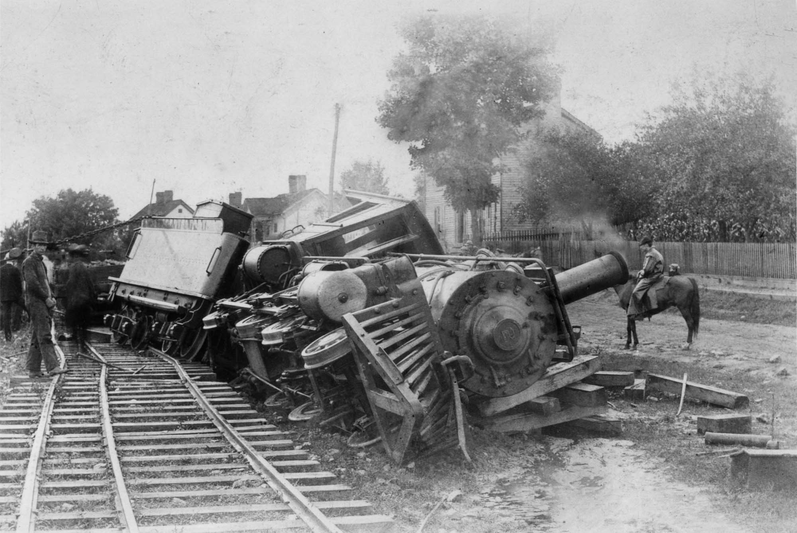
Lock-in: Negative
Is negative lock-in really that bad?

Slide 11
Lock-in: Negative
Is negative lock-in really that bad?
  Higher prices
    Extortion?
  Inaccessible
    Digital divide
  Stymies innovation
    Would the world be better off if Linux had been more successful on the desktop?
Answer: YES! Don't let them get enough leverage

Slide 12
Lock-in: Prevention
Free Software Foundation - Defending the four freedoms:
    The freedom to run the program, for any purpose
    The freedom to study how the program works, and change it so it does your computing as you wish.
    The freedom to redistribute copies so you can help your neighbor.
    The freedom to distribute copies of your modified versions to others

Slide 13
Lock-in: Software
The four freedoms and lock-in
  Makes negative lock-in in software difficult
    Data formats cannot be hidden
    Protocols may be re-implemented
    Don't like it? Fork it.
Why did the four freedoms not prevail in every case?
  Too much leverage

Slide 14
Lock-in: The Cloud
Question:
What do all major cloud service providers have in common?

Slide 15
Lock-in: The Cloud
Answer:
They all depend on open source software

Slide 16
Lock-in: The Cloud
Question:
Is the cloud open source?

Slide 17
Lock-in: The Cloud
Answer:
It's up to us.

Slide 18
Lock-in: The Cloud
Why is the cloud different?
  Interfaces
    Hide backend software behind APIs
  Distribution
    Web services apps are hosted, not distributed, per se
  All about services

Slide 19
Lock-in: The Cloud
Previous attempts to fix the cloud
  GPL v3
    Web service loophole taken out
  Affero GPL
    Redefined distribution to include web services
    Deemed too restrictive by most hosting services
  Open Cloud Manifesto
    Lots of strong language
    Lots of +1's
    No actual solutions

Slide 20
Lock-in: The Cloud
Does source code matter?
  Yes, but...

Slide 21
Lock-in: The Cloud
What is cloud lock-in?
  Positive
    Superior performance
    Operations competence
    Services that only exist with one service provider
  Negative
    Proprietary data formats
    Inaccessible raw data, even if you “own” it
    Contextual services, ie. services augmented with ancillary, proprietary data
    APIs that cannot be legally re-implemented or reverse engineered
    Bandwidth caps for data extraction

Slide 22
Lock-in Layers of the Cloud
IaaS
PaaS
Apps/SaaS
- Overwhelmingly open source
- Services difficult to migrate
- Can be reverse-engineered
- Mix open source & proprietary
- Services difficult to migrate
- Difficult to re-implement
- Mostly proprietary
- Services very difficult to migrate
- Difficult to reverse-engineer & re-implement

Slide 23
Lock-in Layers of the Cloud
IaaS
PaaS
Apps/SaaS
Open questions:
What does it mean to be portable?
What level of service portability is sufficient?
OCI take: A minimum of open standards and interfaces will at least give developers and end users a choice.

Slide 24
Open Cloud Initiative
What is the Open Cloud Initiative?
  The OCI is an organization attempting to create the equivalent of the four freedoms for the cloud
    Minimize negative lock-in
    Reward innovation
    Protect freedoms of developers and users
    Create sustainable ecosystem of participants
  Individuals, not vendors
  501(c)(3) non-profit California corporation

Slide 25
Open Cloud Initiative
Open Cloud must meet the following requirements:
  Open Formats: All user data and metadata in Open Standard formats.
  Open Interfaces: All functionality exposed via Open Standard interfaces.
Open Standards must meet the following requirements:
  Copyrights: The standard must be documented in all its details, published and both accessible and [re]usable free of charge.
  Patents: Any patents possibly present on [parts of] the standard must be irrevocably made available on a royalty-free basis.
  Trademarks: Any trademarks possibly present on identifier(s) must be used for non-discriminatory enforcement of compliance only.
  Implementations: There must be multiple full, faithful, independent and interoperable implementations (for both client and server where applicable) with one OSI-compliant implementation

Slide 26
Open Cloud Initiative
How do we plan to eliminate negative lock-in in the cloud AND create a flourishing ecosystem?
  Start at the community level
    Developer outreach
    Build awareness of cloud lock-in
  Open Cloud Certification and Trademarks
    Decided by community
    Grant organizations the use of 'Open Cloud' mark

Slide 27
OCI: Current Status
Certification working group
  Creating program for meeting open cloud criteria
    Due next month
    Community will vote on whether given service provider is “open cloud”
  Creating program for reaching out to developers
    Build industry consensus one developer, end user and startup at a time

Slide 28
OCI: Governance
By-laws and Articles of Incorporation similar to OSI
Community model also similar to OSI

Slide 29
http://www.opencloudinitiative.org/

